Slide 1
Agency: PowerSave Green Campus Project: Water conservation sticker

Slide 2
What is the PowerSave Green Campus Program?
Student-led energy and water conservation program
Founded by the Alliance to Save Energy in 2004
Funded by the ratepayers of California utilities
Currently on 16 campuses in California, 7 campuses in the Tennessee Valley Authority, and 1 campus in Baltimore

Slide 3
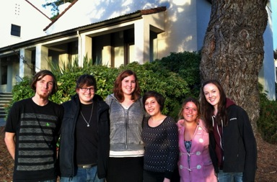
Humboldt State PSGC Team
PSGC present on campus since 2004
Team of 5 Project Coordinators and 2 for-credit interns
Recent projects
Campus Conservation Nationals
Water Awareness Month
Left to Right: Johnny Lococo, Jenna Bader, Adrienne Spitzer, Anais Rodriguez, Rachael Londer, Brietta Linney, Anna Rhoads (not pictured)

Slide 4
Project Description
What?: Behavior change sticker
Where?: Bathroom and kitchen sinks around campus
Why?: Promote water conservation when washing/soaping hands
Who?: Faculty, staff, students, visitors
How?: Effective visual design and catch phrase

Slide 5
Why Water?
Every Drop Counts!
Most Americans are privileged, with access to clean, safe drinking water
Global water crisis will affect us all, we need to be prepared
Promote deep-rooted, long-lasting water conservation behaviors that will be necessary in the future
Saving water = saving energy
= saving $$$
www.monkeyland.co.za
Fact:
Worldwide, nearly 1 billion people lack access to safe, clean drinking water. (www.water.org)

Slide 6
Project Guidelines
Final design:
Must include the PSGC logo and program funder banner
Clearly convey water conservation behavior
Use at least one image and at least one line of text
Aesthetically pleasing with artistic design or details
Dimensions: 4.5” x 5.5”
Orientation & shape: Open
Color & Font: Open
Creativity: YES, PLEASE!

Slide 7
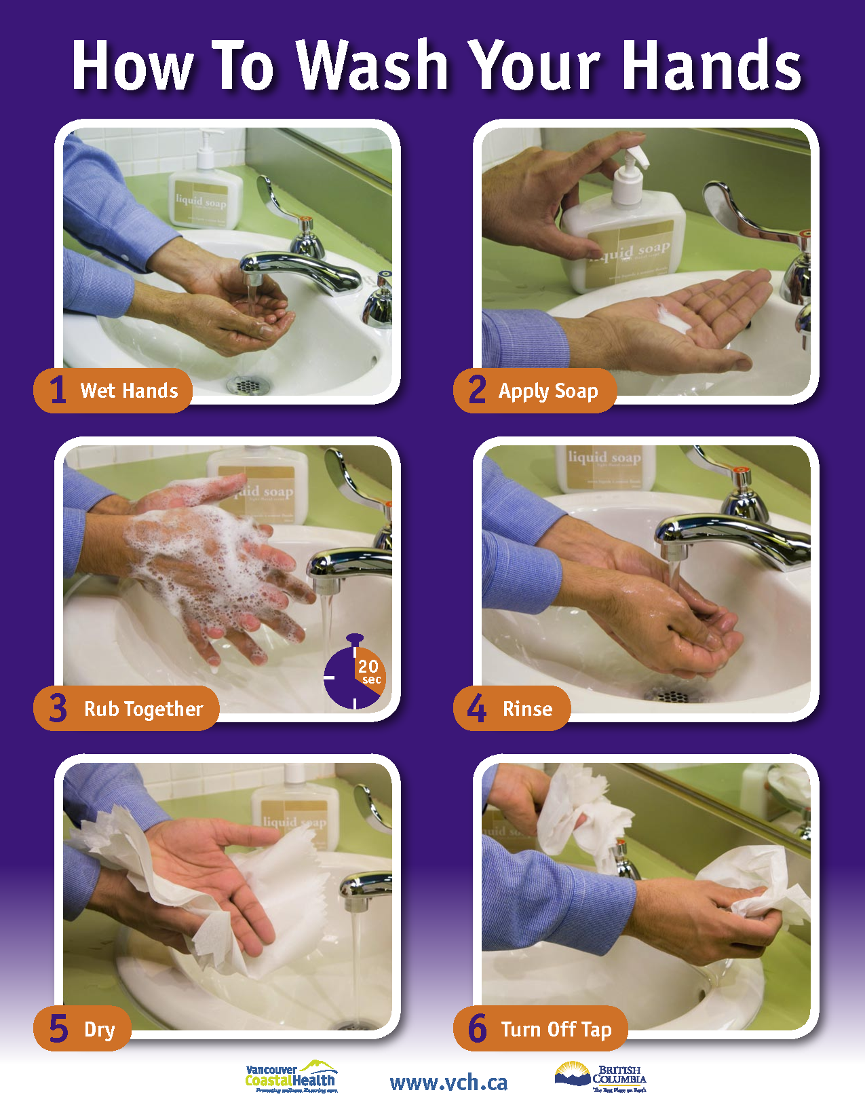
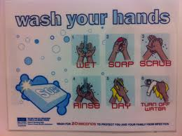
Brainstorming
Wash away water inefficiency at Humboldt State
Step 1: TURN OFF WATER WHEN SOAPING HANDS
Step 2: Green Seal Certified Soap
Step 3: Water conservation tip, fact, or image
Step 4: RINSE
Step 5: Low-flow faucet aerator
Step 6: Shut OFF water valve tightly
www.docstoc.com
http://dl004d.blogspot.com

Slide 8
Brainstorming
www.vogue.com
www.sustainability.ucsf.edu

Slide 9
Resources
www.water.org
http://blueplanetnetwork.org/water/
www.powersavehsu.com
www.humboldt.edu/green/features/operations.php
http://www.good.is/posts/good-design-sarasota-three-ideas-for-conserving-and-celebrating-water
Google image search: Water conservation sticker

Slide 10
Contact Info.
Jenna Bader
Personal e-mail: JLB272@humboldt.edu
Website: www.powersavehsu.com
Team e-mail: powersavehsu@gmail.com

